Slide 1

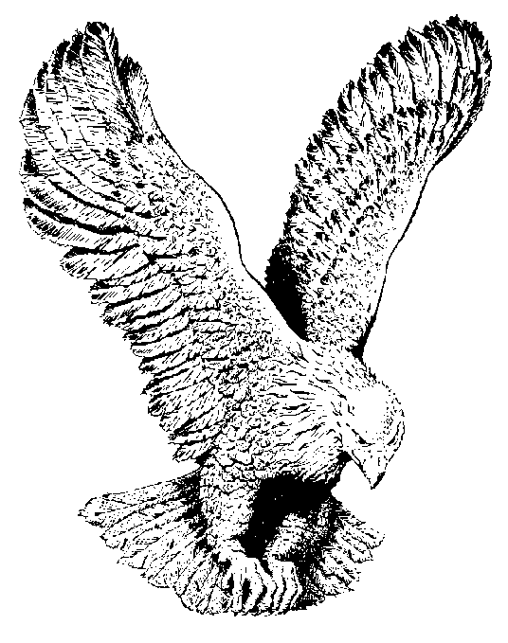
742 ANYWHERE HE WENT
Everywhere He went, He was doing good
The Mighty healer, He healed the leper
When the crippled saw him
They started walking
Everywhere He went
My Lord was doing good.

